Slide 1
1.3 DSRIP Quality Related Outcomes: Round3
Hye-Chung, Chad, Franchesca

Slide 2
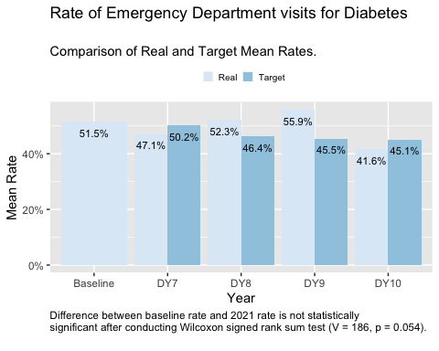
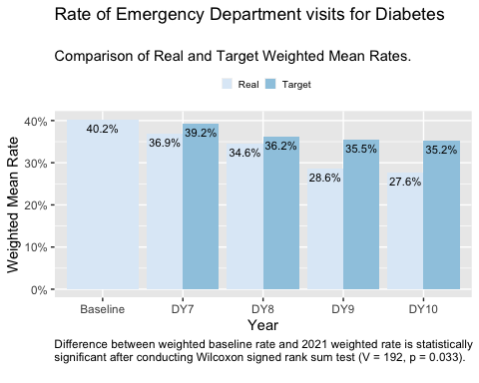
Measure 1.3.1 - Analysis of Achievement Rates

Slide 3
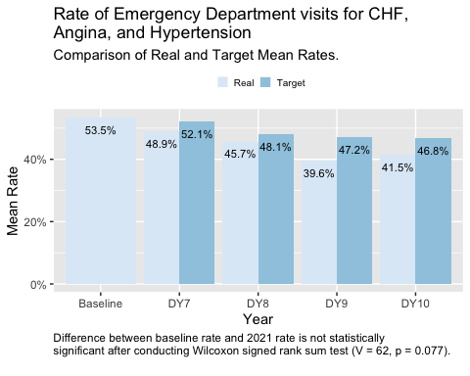
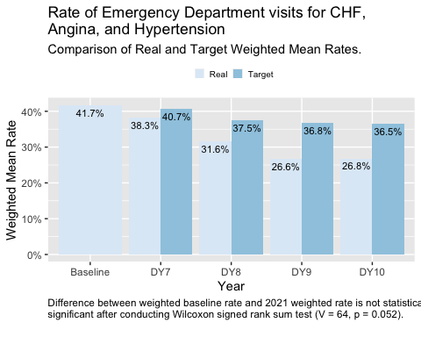
Measure 1.3.2 - Analysis of Achievement Rates

Slide 4
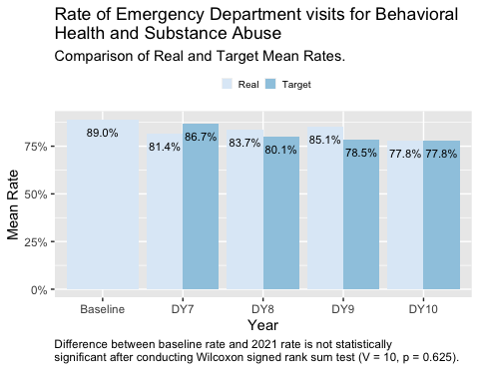
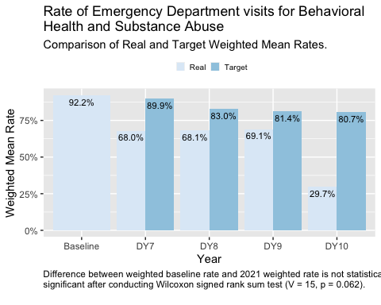
Measure 1.3.3 - Analysis of Achievement Rates

Slide 5
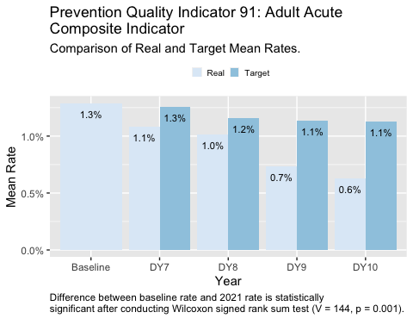
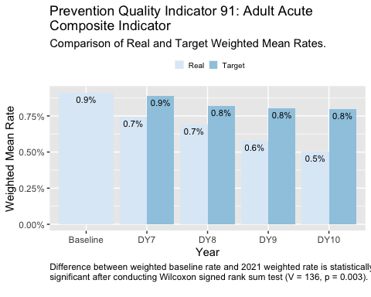
Measure 1.3.4 - Analysis of Achievement Rates

Slide 6
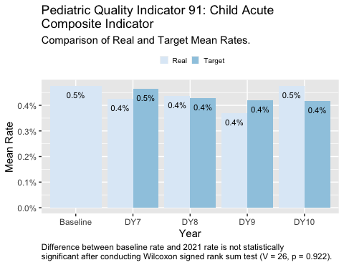
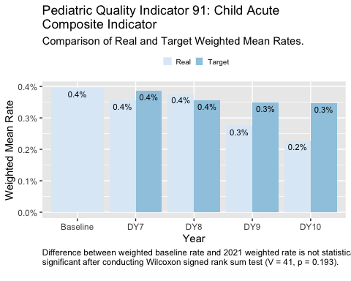
Measure 1.3.5 - Analysis of Achievement Rates

